Slide 1


ECEN 404 Update #4 Heliostat Control Tracking Team #66
Jordan George, Samuel Dixon Sponsor: Dr. Madsen
TA: Dalton Cyr
Solar Controller

Slide 2
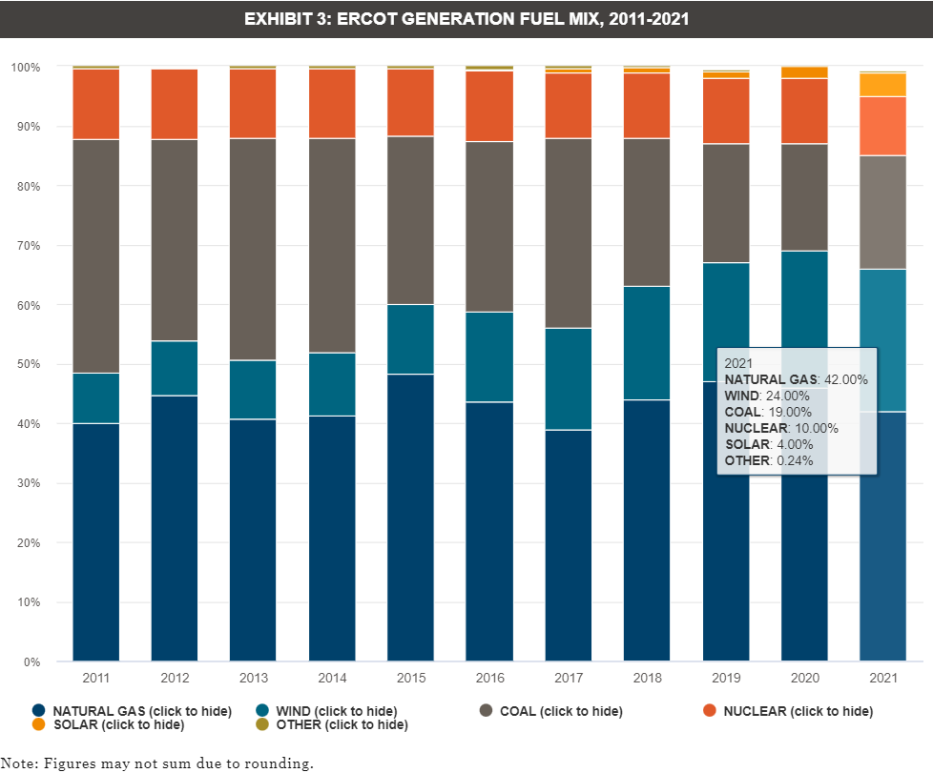
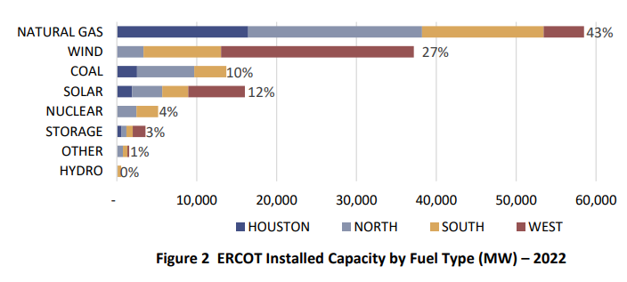
Problem Statement
Necessity for rapid change of energy source partition
Done on basis of conscious consumption and environmental need
Apparent growth, but room for improvement
*Images Adapted from Ercot Case Study

Slide 3
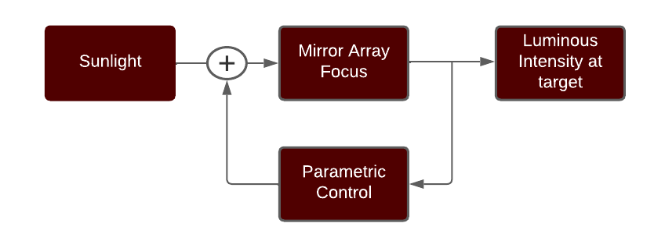
Executive Summary
Track the Sun’s movements with feedback parameters through a Fresnel Lens and focus light onto a target
Notes:
The goal of this research project is to help develop a heliostat for a small-scale solar thermal system consisting of a heliostat to Fresnel lens to target optical path. Currently, heliostat manufacturers design their products for very large CSP systems (concentrating solar power, i.e. power towers) that are not suitable for this R&D project as it would be too cumbersome, costly, possible proprietary issues, and the timeline would be unpredictable.
Problem statement: To demonstrate basic system performance in a timely manner, we will assemble a heliostat and demonstrate solar tracking, through a lens, to a focused target spot with motor control for two axis positioning of the heliostat into a fixed lens/target fixture and incorporate position feedback for closed loop operation. Having a stand-alone heliostat unit that can be easily setup, measured under sun, and returned to the lab for storage is desired. A small battery and possibly a PV panel and controller should be integrated onto the heliostat unit. Wireless control, sensor feedback, possibly a camera on the target area, data acquisition and data logging are desirable using a laptop (MS Windows) and Matlab. The solar input should be measured and an estimate of the solar energy delivered to the target area made (more on this later, we have to measure the direct normal irradiance - ie. DNI - separate from the global horizontal irradiance using a homemade rotating shadowband on an Apogee pyranometer).
Safety is paramount, so starting with a small reflecting area and small lens (eg. around 1 square foot each) will limit the focused beam intensity for initial experiments and aid in the development of safety procedures, control, and hardware to be implemented before focusing larger areas. For larger areas, the focused beam can burn through a metal plate so care must be taken during alignment and tracking as well as the beam "off" process.
Many factors will influence the alignment of the optical path. Alignment errors include misalignments (heliostat and lens/target on separate mounts), motor backlash and motor-induced vibration, and wind.
In the future, we can consider tilting mirrors in the heliostat array for some additional concentration; however, we should start with a planar surface to understand the basic tracking and alignment challenges. Then, we can model the tilt behavior before committing to a more complex hardware implementation.

Slide 4
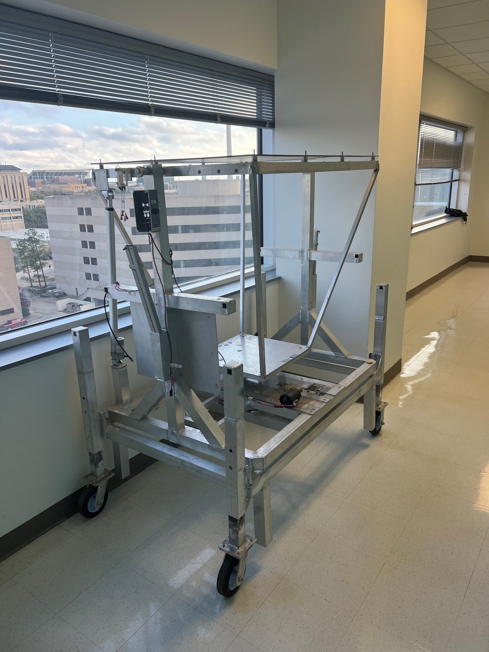
System Overview
Key:
Current Manual Control
Lazy Suzan Rotation Motor
Linear Actuator Motor
Accelerometer Mounting
PCB Mount

Slide 5
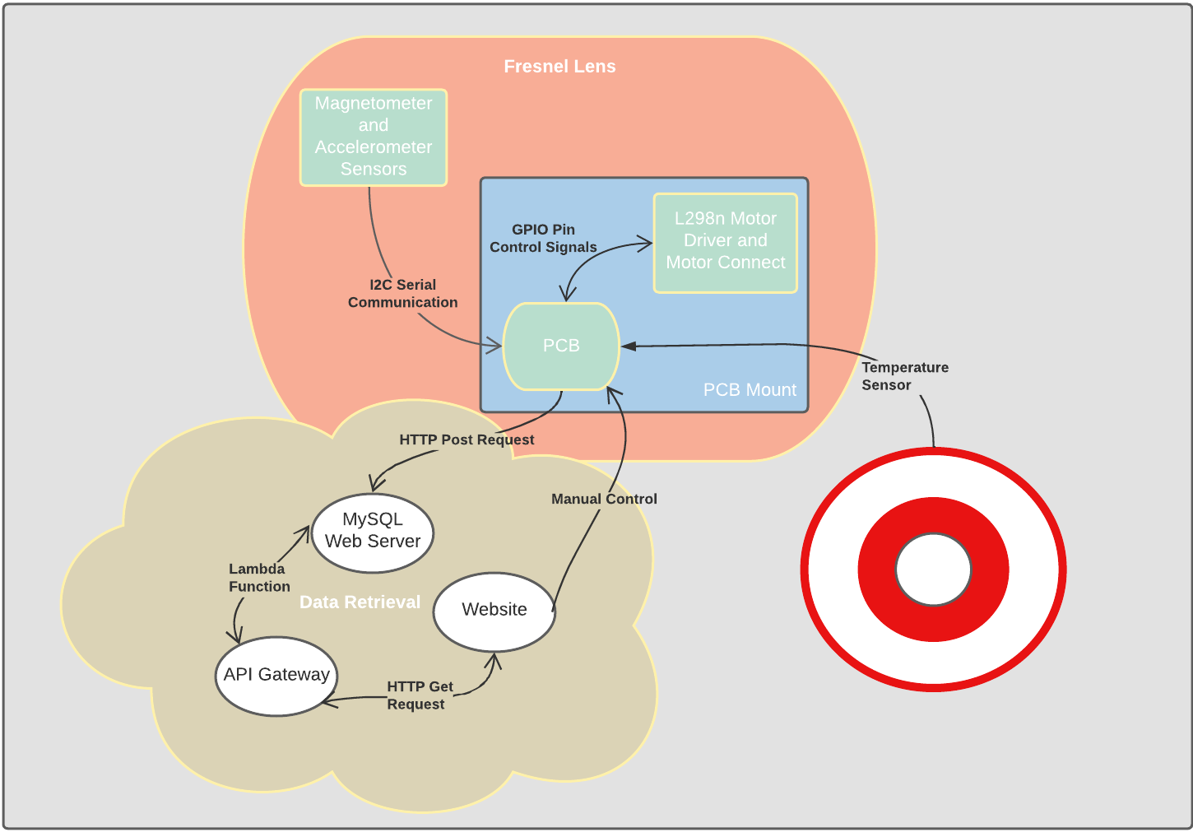
System Owners
Jordan
Sam

Slide 6
Project Timeline
1/27/2023
2/20/2023
3/10/2023
4/1/2023
5/2/2023
403 Recovery
Beginning Integration
Final Validation
Demonstration to Sponsor
Subsystem integration
Repartitioning Subsystems, and finalizing individual subsystems
Finishing 403 recovery and testing functionality of I2C serial communication and tracking controls algorithm with motors
Demonstrate microprocessor-based control of rotation and tilt motion to a specific direction of the calculated sun's position, with magnetometer measurement of azimuth and elevation with an accelerometer measurement.
Continue to refine automatic tracking algorithm if needed as well as further debugging to prepare for the final demo.
Full testing and evaluation of performance capability, evaluation of tracking accuracy, full documentation of hardware design, software programming and data pathway for transition to future researcher(s)

Slide 7
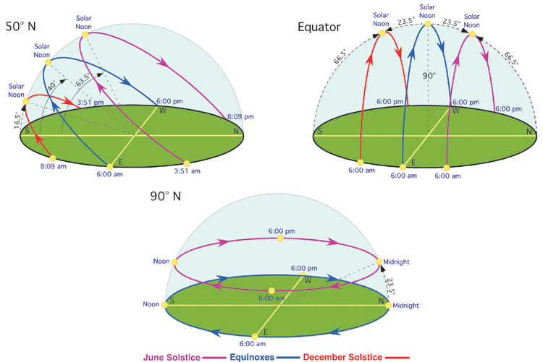
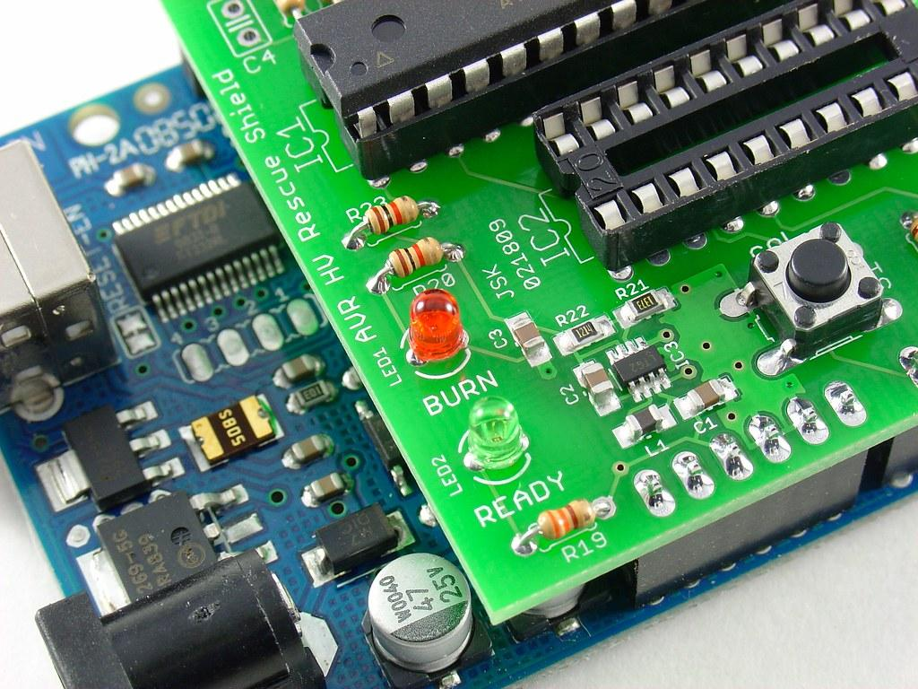

Jordan + Sam
Jordan
Sam
Tracking Control Software
PCB Layout
Data Visualization

Slide 8
PCB & Tracking Control Subsystem
Jordan George
Completed in the last 2 weeks Hours of Effort: 29 hours | Ongoing progress and goals for next 2 weeks
Flashed code onto PCB that was able to connect to Wifi, get the current time/date, and output the current azimuth and elevation angle Ran code on test ESP32 devkit that would get the current sun angles and update the test motors every 10 mins | Fix USB port connection on PCB Figure out scaling for automatic control algorithm

Slide 9
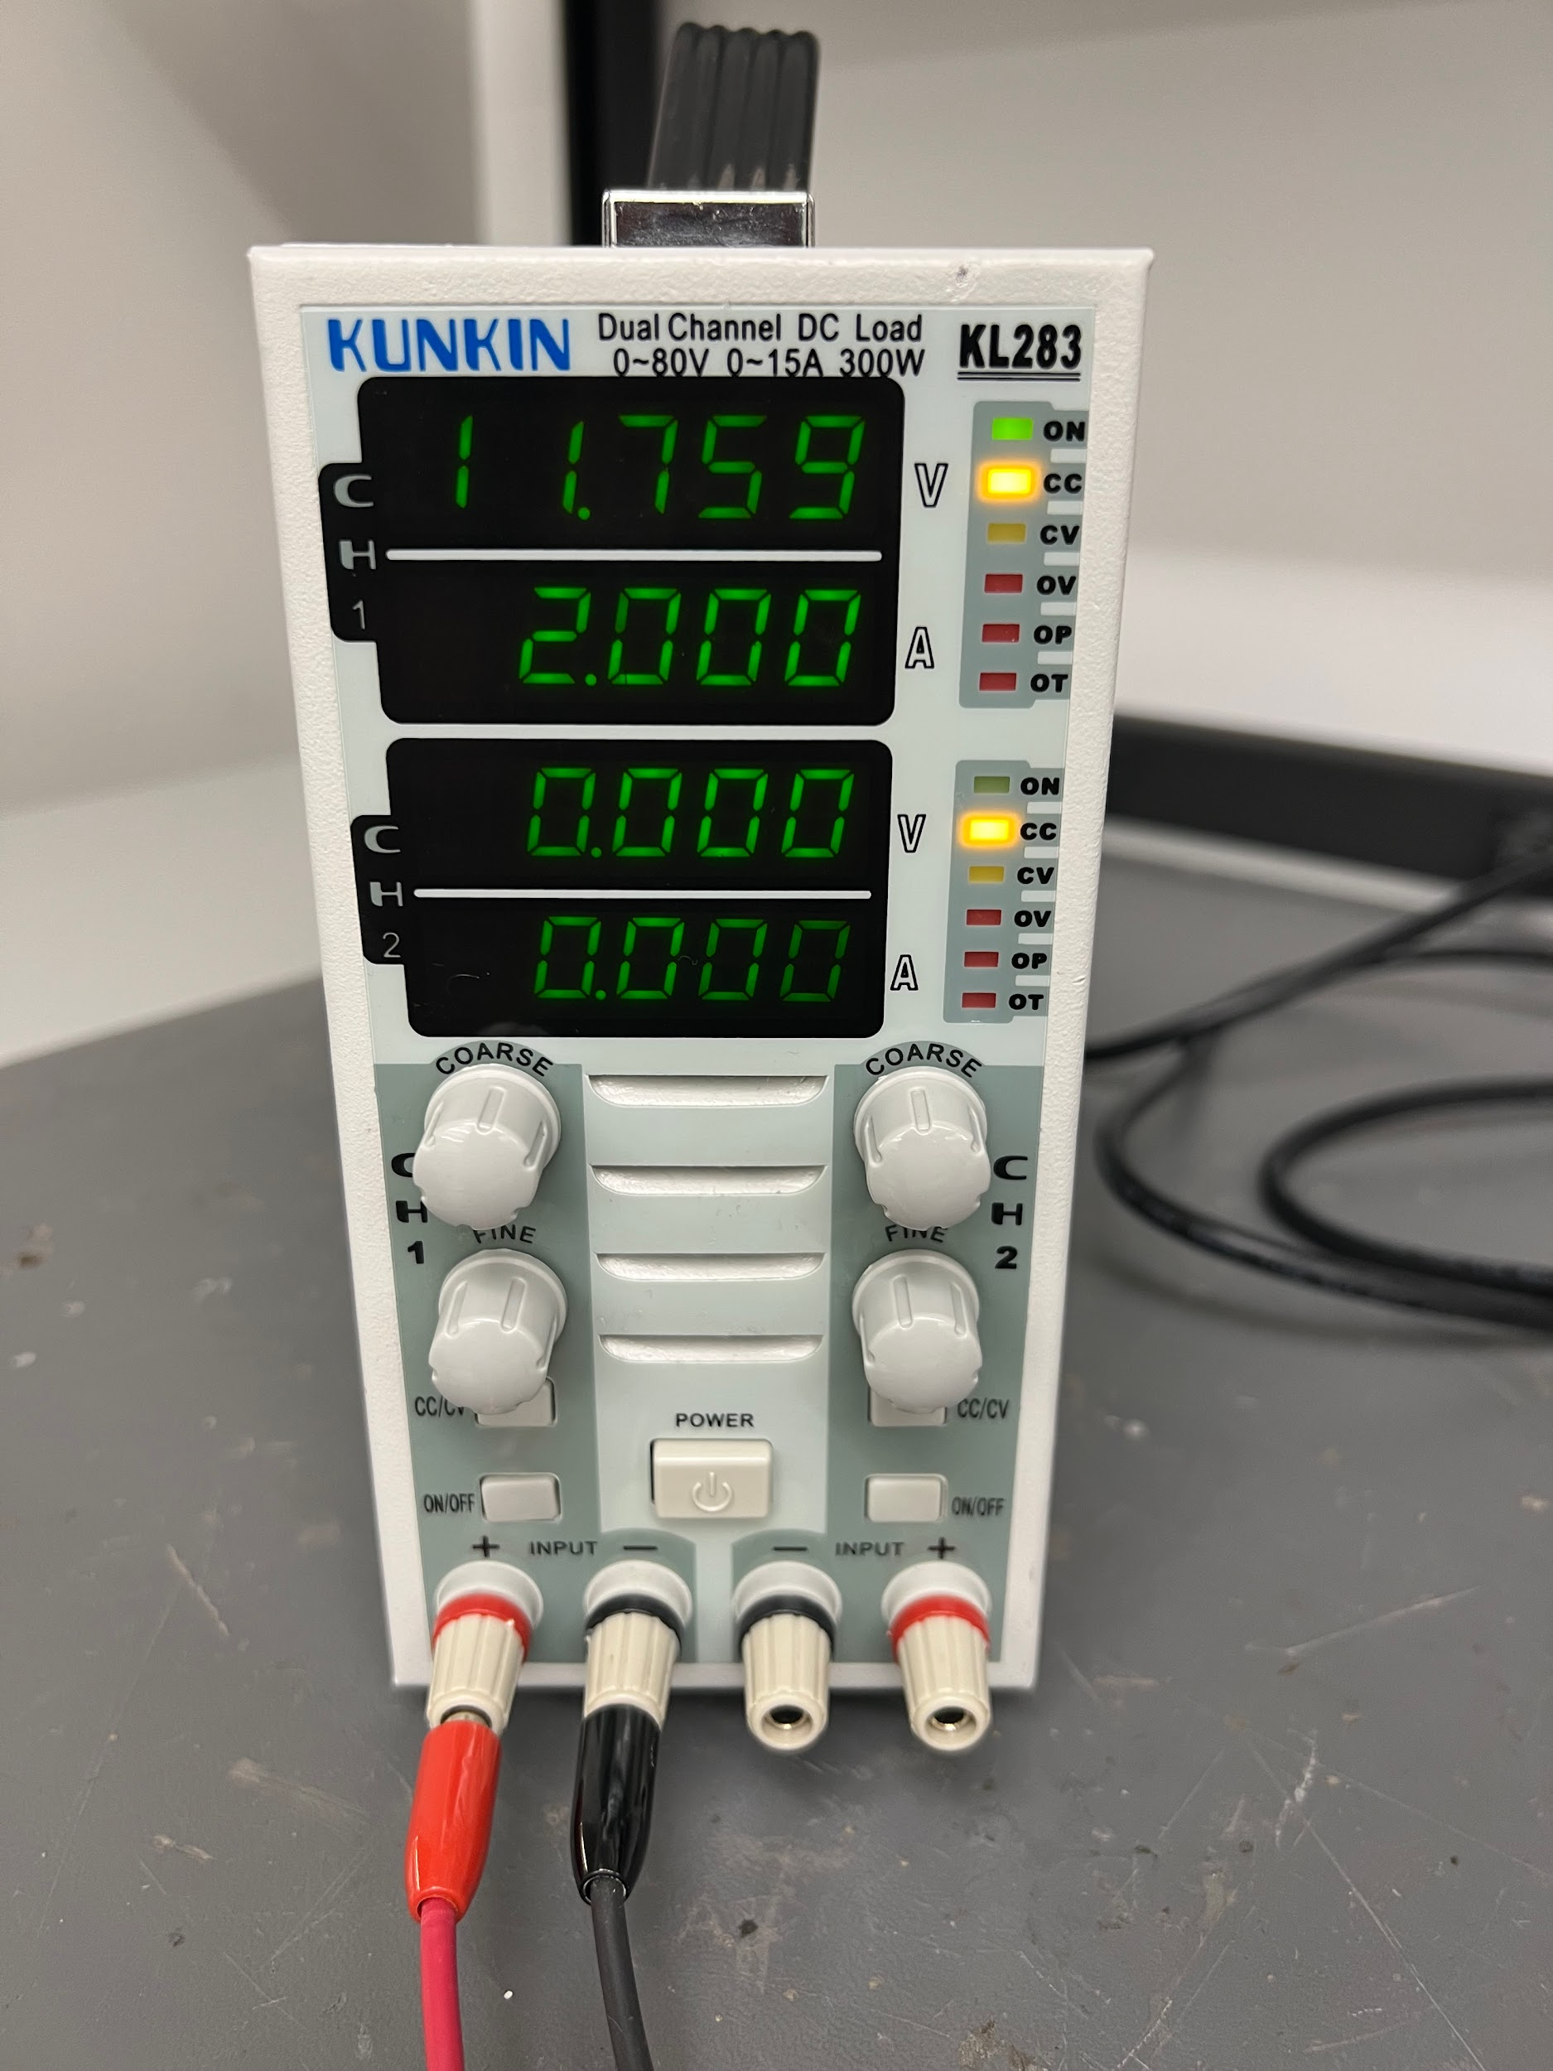
PCB Subsystem
Tested new H-bridge terminal with E-load with a 12 V input to PCB
Current Draw (A) | Voltage at terminal (V)
0.504 | 11.969
1.000 | 11.899
1.500 | 11.830
2.000 | 11.759
2.500 | 11.689

Slide 10
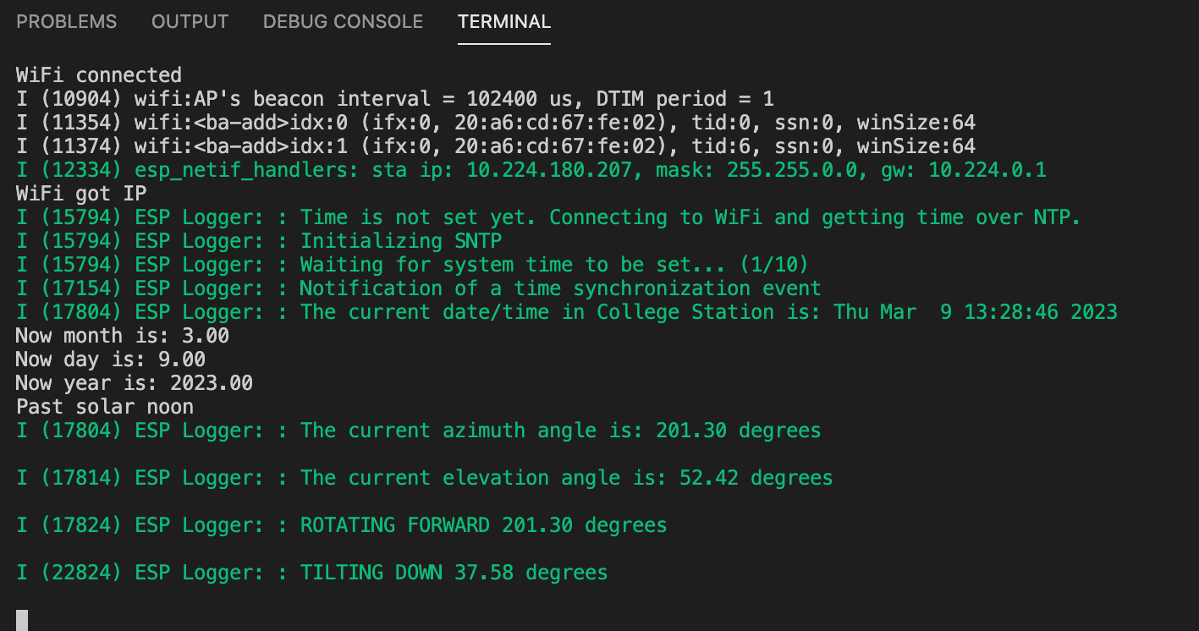
Tracking Control Subsystem
Monitor of PCB when updated code was flashed onto it:

Slide 11
Jordan + Sam
Jordan
Sam
Tracking Control Software
PCB Layout
Data Visualization + UI

Slide 12
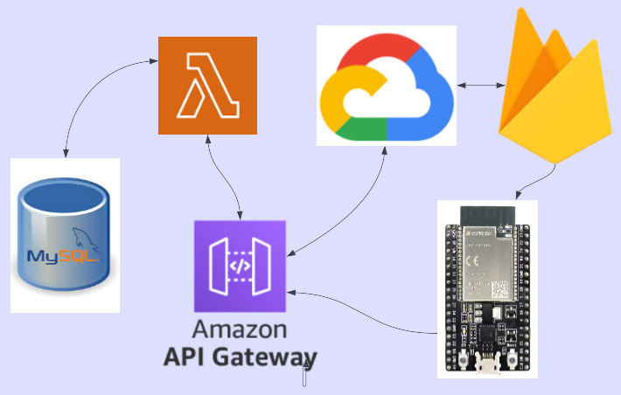
Data Visualization Subsystem

Slide 13
Data Visualization and I2C Sensor Subsystem
Samuel Dixon
Completed in the last 2 weeks Hours of Effort: 30 | Ongoing progress and goals for next 2 weeks
Calibrated Magnetometer via MotionCal software Integrated Microcontroller post request with with backend lambda script PWM Manual Control X/Y 4 quadrant cartesian grid sweep on lab motors | Integrate website to parse MySQL data via GET request CAD Modelling and 3D print for system mounting

Slide 14
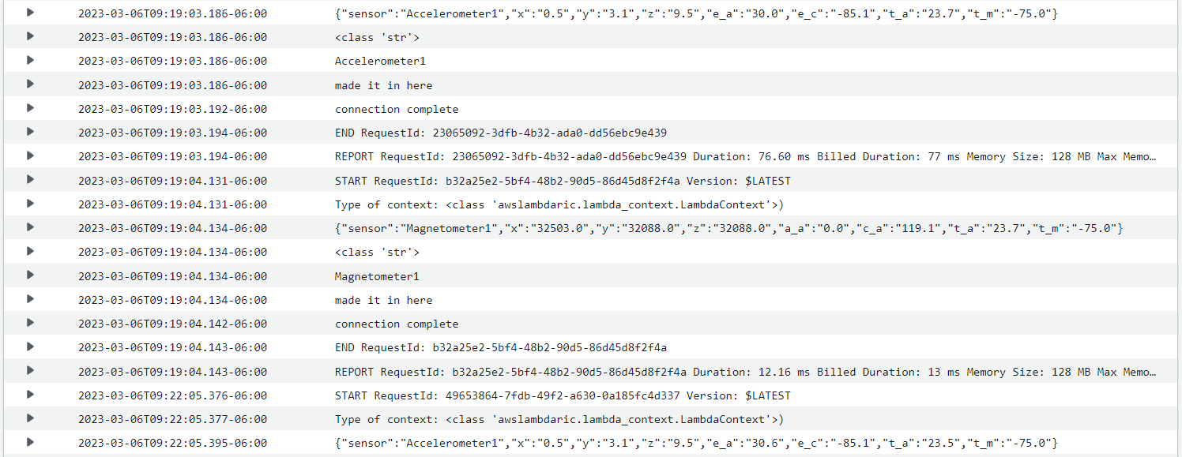
AWS Cloud Watch Log
Latency tested at approximately 10 second intervals (guardband)
routine will likely work on 10 minute interval

Slide 15
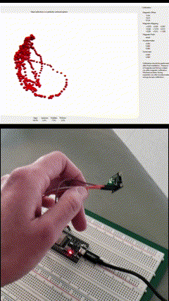
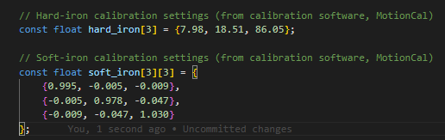
Magnetometer Calibration
Credit to MotionCal software by Paul Stroffegen open source tool for calibrating readings
Ongoing - integration of calibration values into ESP32 program

Slide 16
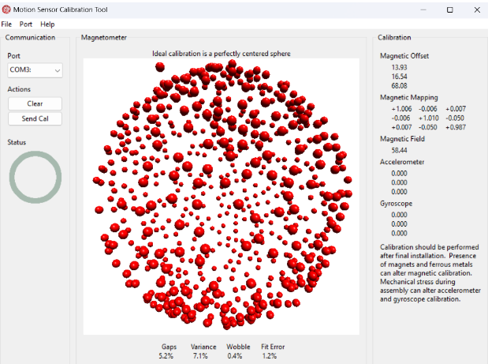
Results

Slide 17
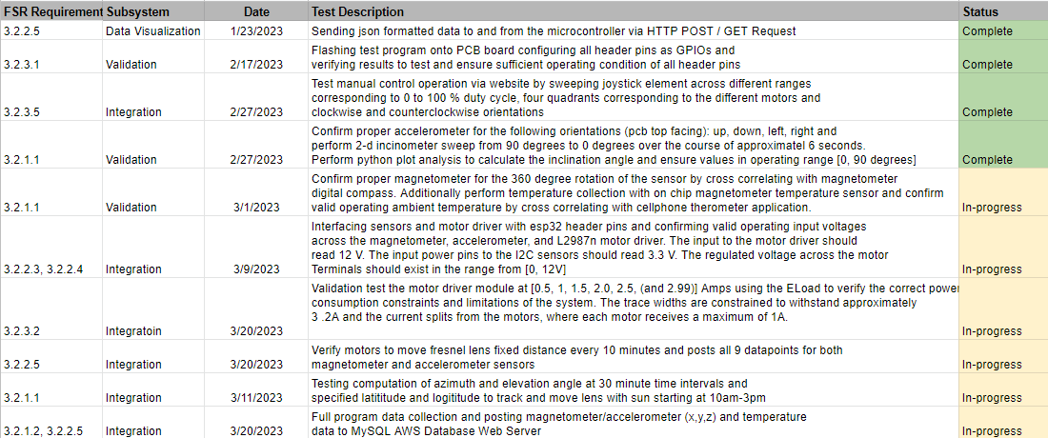
Validation Plan

Slide 18
Q&A
Thank you for listening to the Heliostat Control Tracking Presentation

